Slide 1

CA-02 DATA VISUALIZATION
Objectives:
Comparative analysis of PCA,UMAP and t-SNE on Client and Patch dataset.
Critical analysis of different client features
Critical analysis of different patch details.

Slide 2
Exploring Clients and Patches Datasets
Clients
Patches
Clients Dataset consists of 43,193 rows with 9 different features.
It gives detailed information about clients of a unnamed bank.
Each row corresponds to a new client.
Patches Dataset consists of 15,120 rows with 7 features.
It gives cartographic information for different 30m × 30m patches in the forests of Alberta, Canada.
Each row corresponds to a observed patch..

Slide 3
Features
Clients
Patches
1 - age (numeric)
2 - job : type of job (categorical: "admin.", "unemployed", "management", "housemaid", "entrepreneur", "student", "blue-collar", "self-employed", "retired", "technician", "services")
3 - marital : marital status (categorical: "married", "divorced", "single"; note: "divorced" means divorced or widowed)
4 - education (categorical: "secondary", "primary", "tertiary")
5 - default: has credit in default? (binary: "yes", "no")
6 - balance: average yearly balance, in euros (numeric)
7 - housing: has housing loan? (binary: "yes", "no")
8 - personal: has personal loan? (binary: "yes", "no")
9 - term: has term deposit? (binary: "yes", "no")
1 - Elevation - Elevation in meters
2 - Slope - Slope in degrees
3 - Horizontal_Distance_To_Hydrology - Horz Dist to nearest surface water features
4 - Vertical_Distance_To_Hydrology - Vert Dist to nearest surface water features
5 - Horizontal_Distance_To_Roadways - Horz Dist to nearest roadway 6 - Horizontal_Distance_To_Fire_Points - Horz Dist to nearest wildfire ignition points
7 - Tree - Tree found predominant in the observed patch. Can be either “Spruce” (meaning Spruce tree was found predominant) or “Other” (meaning trees other than Spruce were found predominant)

Slide 4
Number of Subsets
We have created 6 subsets for Clients dataset
We have created 4 subsets for patches dataset

Slide 5
Subset with the variable used.
Clients
Patches
Subset 1: job, marital, education,default, balance,housing,personal.
Subset 2: age, job, education, balance, personal,housing.
Subset 3: age, job, marital, balance, housing, personal,education.
Subset 4:job, marital, education, default, balance, housing,age.
Subset 5: age, marital, education, balance, housing, personal,job.
Subset 6: default,balance,housing,personal.
Subset 1 : Slope, Horizontal_Distance_To_Hydrology, Vertical_Distance_To_Hydrology, Horizontal_Distance_To_Roadways, Horizontal_Distance_To_Fire_Points.
Subset 2: Elevation, Slope, Horizontal_Distance_To_Hydrology, Tree.
Subset 3 : Elevation, Slope, Vertical_Distance_To_Hydrology ,Tree
Subset 4: Elevation , Slope, Horizontal_Distance_To_Hydrology, Horizontal_Distance_To_Roadways,Tree.

Slide 6
Methodology
Visualizing Clusters
Dimension reduction techniques using k-means labels
Applying k-means to generate labels
Data Pre-Processing

Slide 7
Comparative analysis of UMAP, t-SNE AND PCA
We tried to implement all three dimensional reduction techniques on both datasets and subsets for Clients and patches data.
PCA with k-means labelling was the worst amongst the three but divided very fast as compared to t-SNE.
T-SNE gave us amazingly good results but took at least 40 mins for each visualization.
UMAP was the best both with clustering and speed.
Hence UMAP is not only the most advanced technique but also the biggest reason for T-SNE being absolute.

Slide 8
Clustering Visualization for Clients data

Slide 9
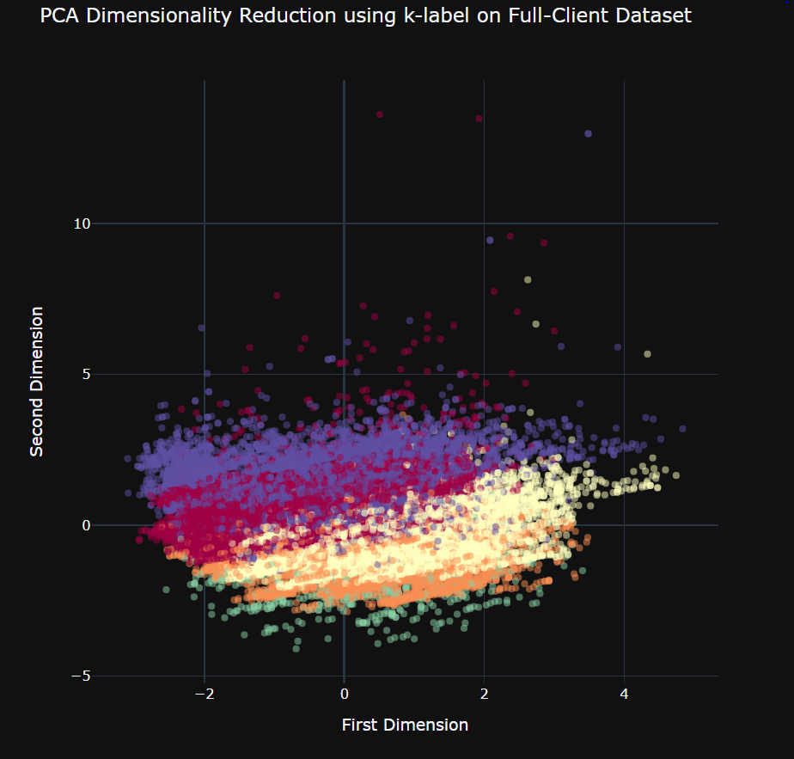
PCA on full Client dataset

Slide 10
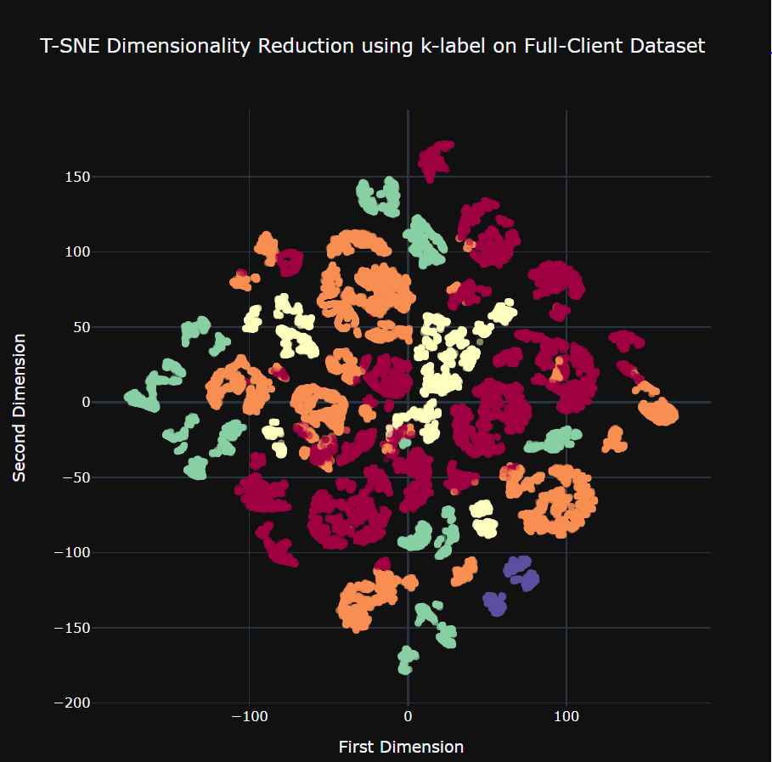
t-SNE on full Client dataset

Slide 11
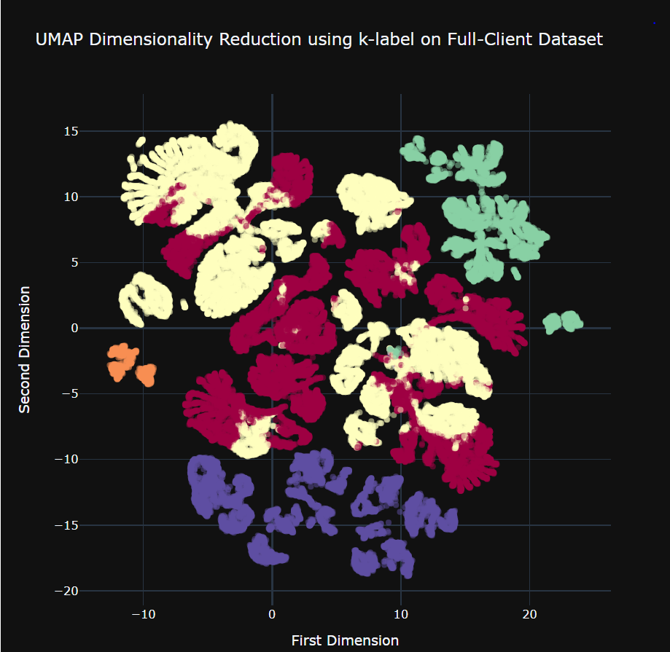
UMAP on full Client dataset

Slide 12
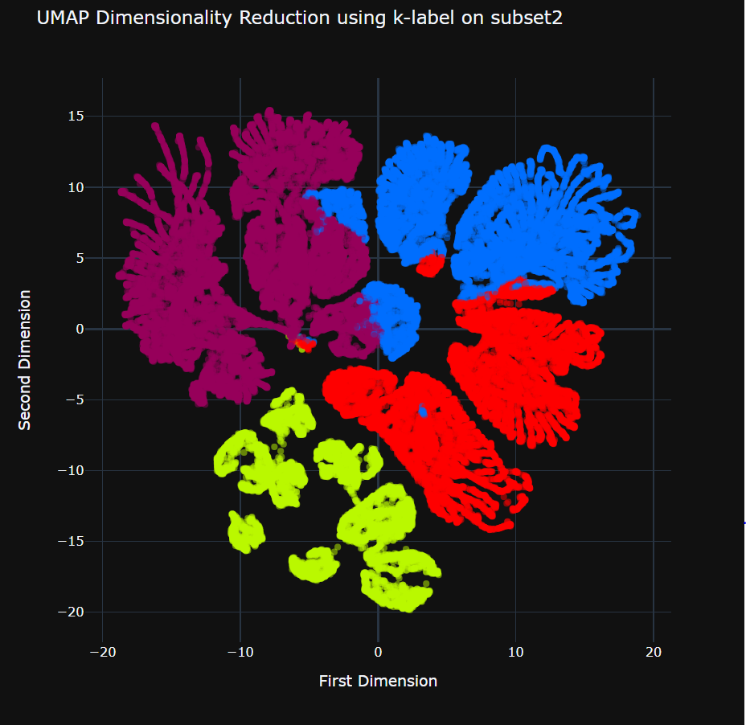
UMAP on Client subset-2

Slide 13
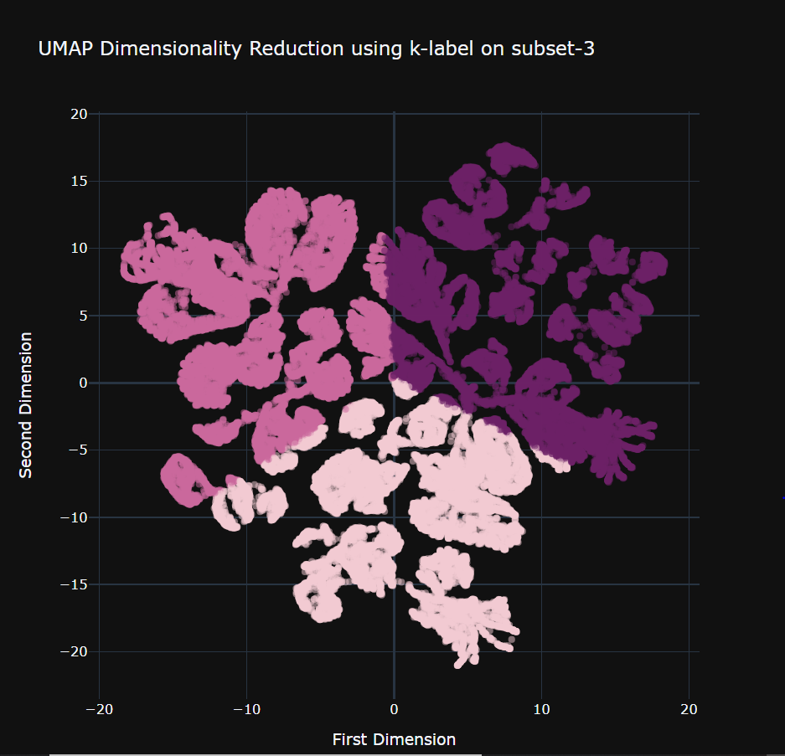
UMAP on Client subset-3

Slide 14
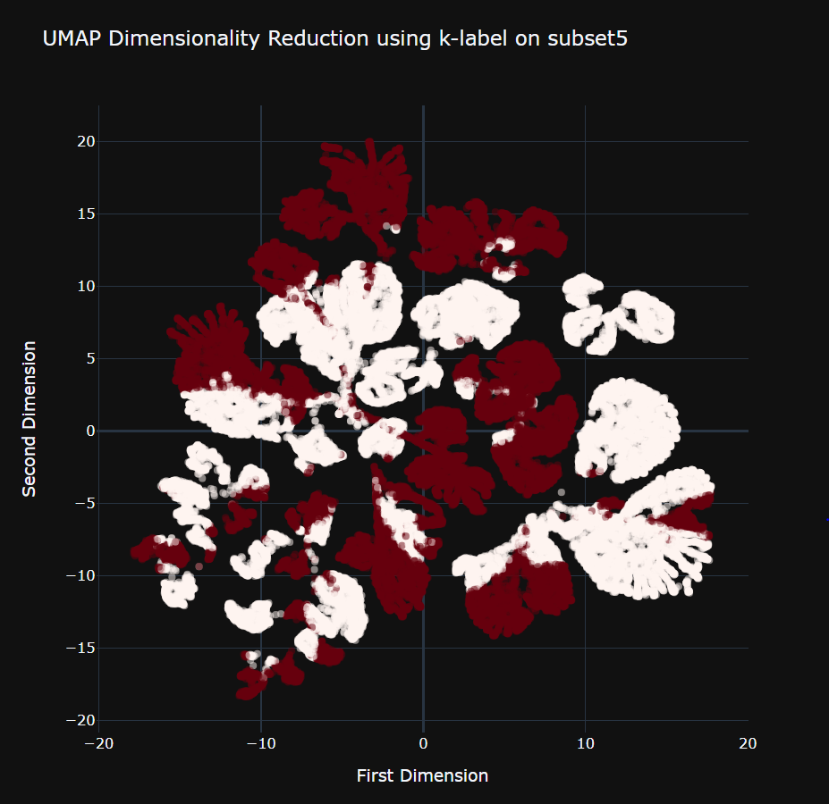
UMAP on Client subset-5

Slide 15
Clustering Visualization for PATCHES data

Slide 16
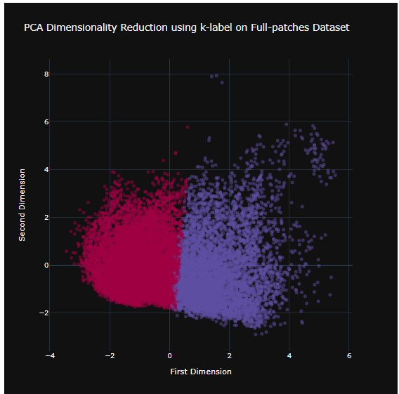
PCA on full patches dataset

Slide 17
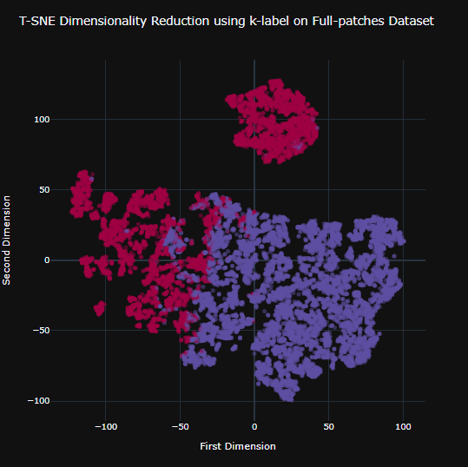
T-SNE on full patches dataset

Slide 18
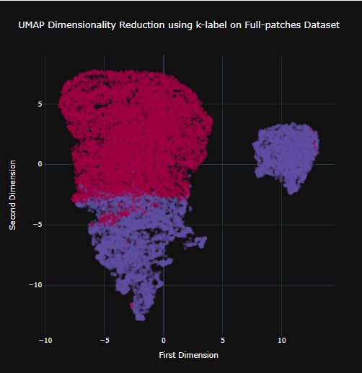
UMAP on full patches dataset

Slide 19
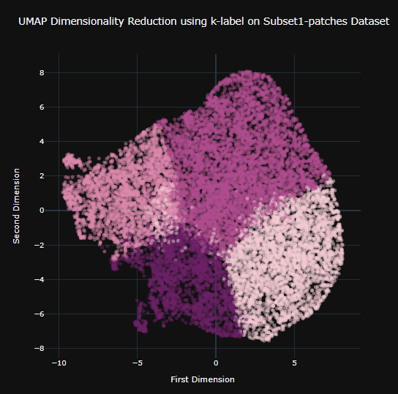
UMAP on patches SUBSET-1

Slide 20
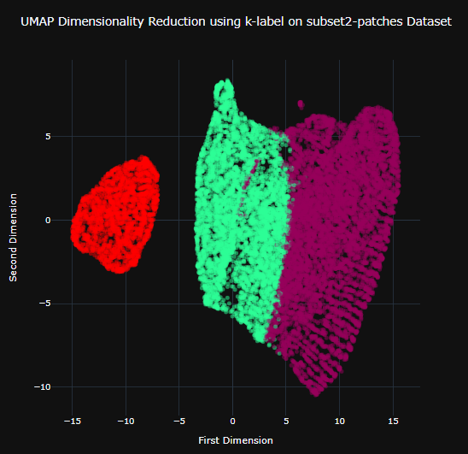
UMAP on patches SUBSET-2

Slide 21
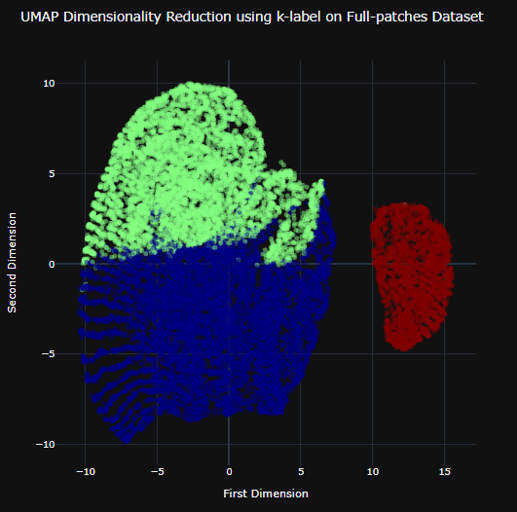
UMAP on patches SUBSET-3

Slide 22
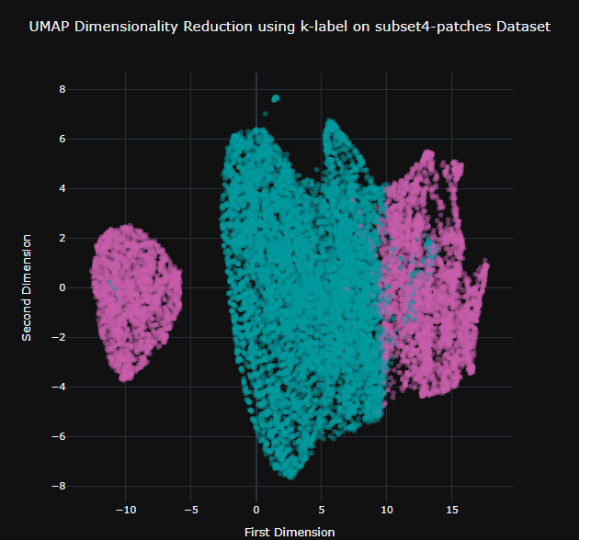
UMAP on patches SUBSET-4

Slide 23
Conclusion
UMAP and t-SNE give almost the same results, but UMAP clustering a bit better.
UMAP, t-SNE, PCA didn’t work well for clients-subset1 and clients-subset6
t-SNE can take life long to run
PCA is only good for basic cluster understanding.

